Slide 1

LOAN ELIGIBILITY PREDICTION WEBAPP
Team Members
G_ID | NAMES
2216126 | AYESHA SHAHANAZ.
2216129 | B. VENKATA LAKSHMI VYSHNAVI.
2216141 | SHIVANI POOSALA.
2216130 | RAHUL RAVALA.
2216107 | SREEJA MANDALA.

Slide 2
INTRODUCTION
Loans are the core business of banks.
The loan companies grant a loan after an intensive process of verification and validation.
Model to predict if an applicant is able to repay the lending company or not.
Immediate and easy way to choose the deserving applicants it can be provide special advantage for bank.
The main portion the bank assent is directly earn the profit.
Today many banks /financial companies approve loans regress process of verification and validation

Slide 3
NEED OF THE PROJECT
The primary goal of this analysis was to increase and use various models to predict the target variable.
we predict if the person is eligible for loan or not.

Slide 4
OBJECTIVES
The main objective is to predict whether assigning the loan to particular person.
It included some point about this Loan Status prediction.

Slide 5
METHODOLOGY
The data was then passed to various models to find the best accuracy in the training set.
Each model’s training was fit using –
DECISION TREE.
RANDOM FOREST.
NAVIE_BAYES.
LOGISTIC REGRESSION.
XG BOOST.
SVM.
KNN.

Slide 6
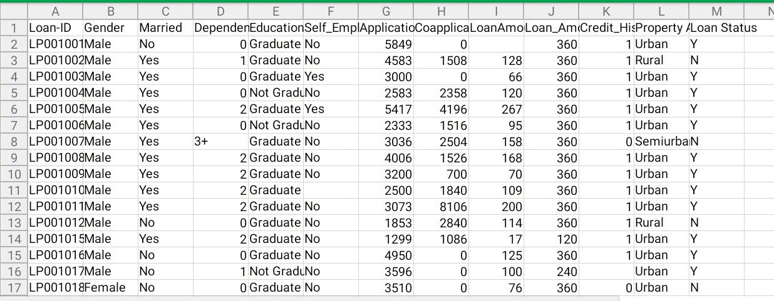
DATASET

Slide 7
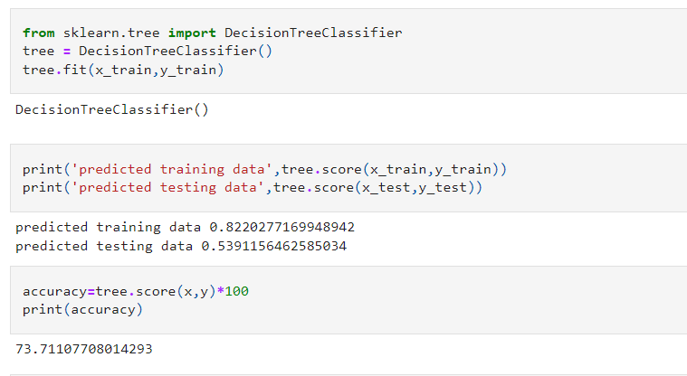
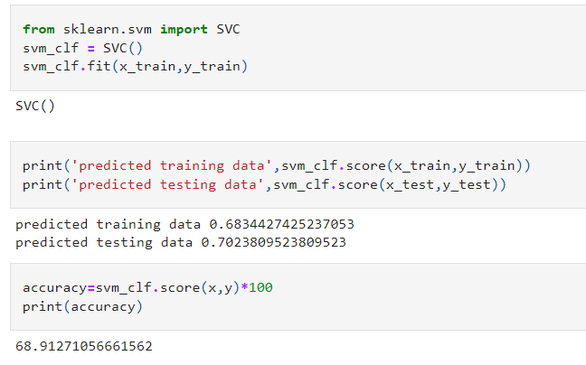
CREATING THE MODEL
This type of dataset needs a classification approach.
DECISION TREE:
SUPPORT VECTOR MACHINE:

Slide 8
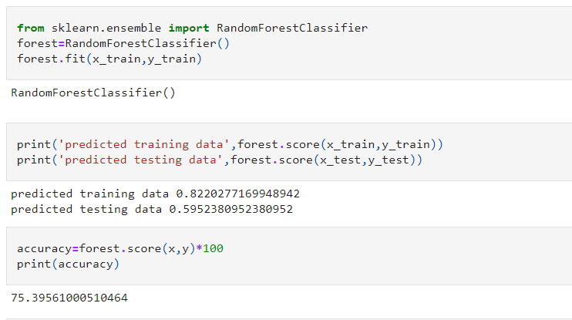
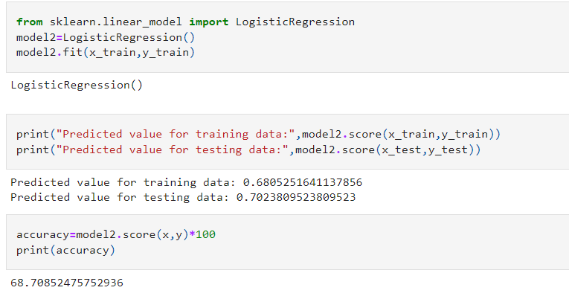

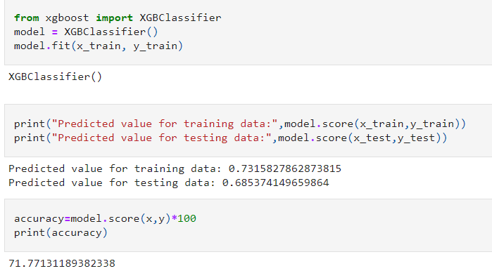
RANDOM FOREST:
LOGISTIC REGRESSION:
K-NEAREST NEIGHBOR:
XG-BOOST:

Slide 9
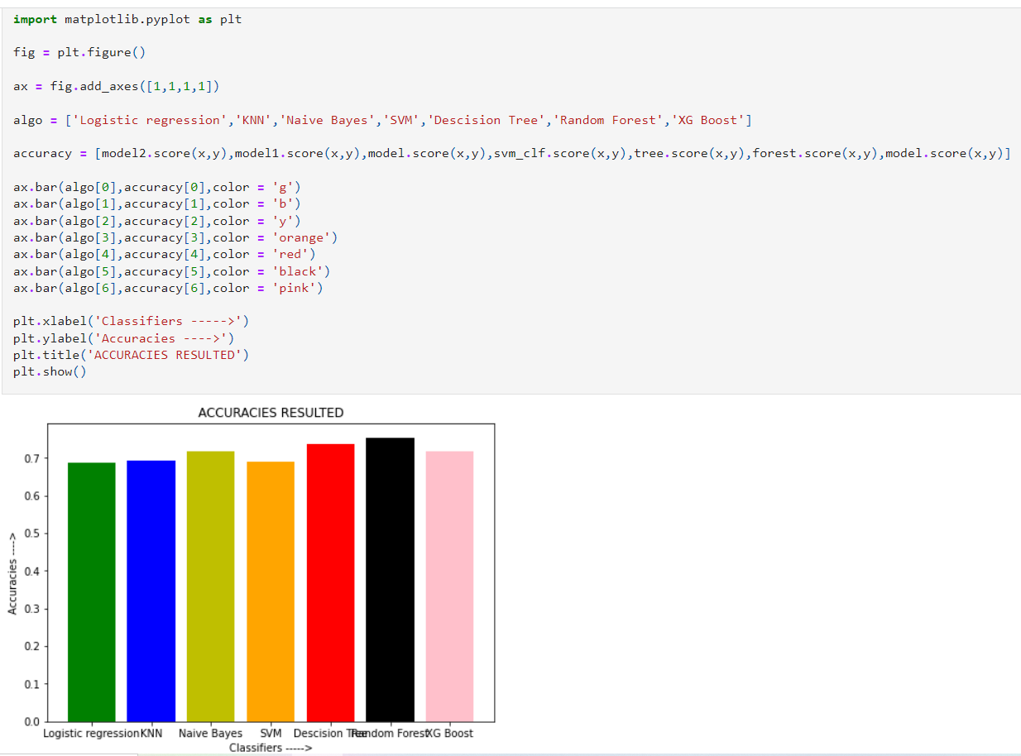

Slide 10
CLOUD

Slide 11
PROJECT DEPLOYMENT
Done with a phase of your project? Let’s go ahead and see how the project is deployed.

Slide 12
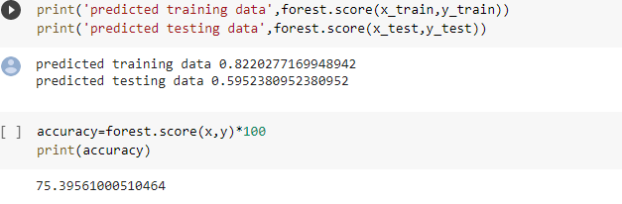
RESULTS
[Random Forest model with highest accuracy]

Slide 13
USE CASES
This application can be used based on applicants, who are eligible for Loan.

Slide 14
EXTENSION OF PROJECT
Want to extend your project? Let’s get into details on how we can take it to the next phase.

Slide 15
CONCLUSION
Finally, we're delighted to see that Random Forest is the best model that we can use for this classification model .Random forest has the highest Accuracy than other models.
Hence , we could use this model to predict the Loan Eligibility.

Slide 16
SLIDE TITLE
Click here to add information
NOTE: If you are having some extra information, copy this slide and paste it below the slide you want to add information.

